Slide 1
UNIVERSAL-GANS
How AI sees the universe

Slide 2
Project Details
36
P2
Dr. P.S. Banerjee
Project No.
21th Nov, 2022
Guide

Slide 3
Table of contents
01
Recap
02
TechStack
03
WorkFlow (Current)
04
Conclusions

Slide 4
01
Recap
Everything so far…

Slide 5
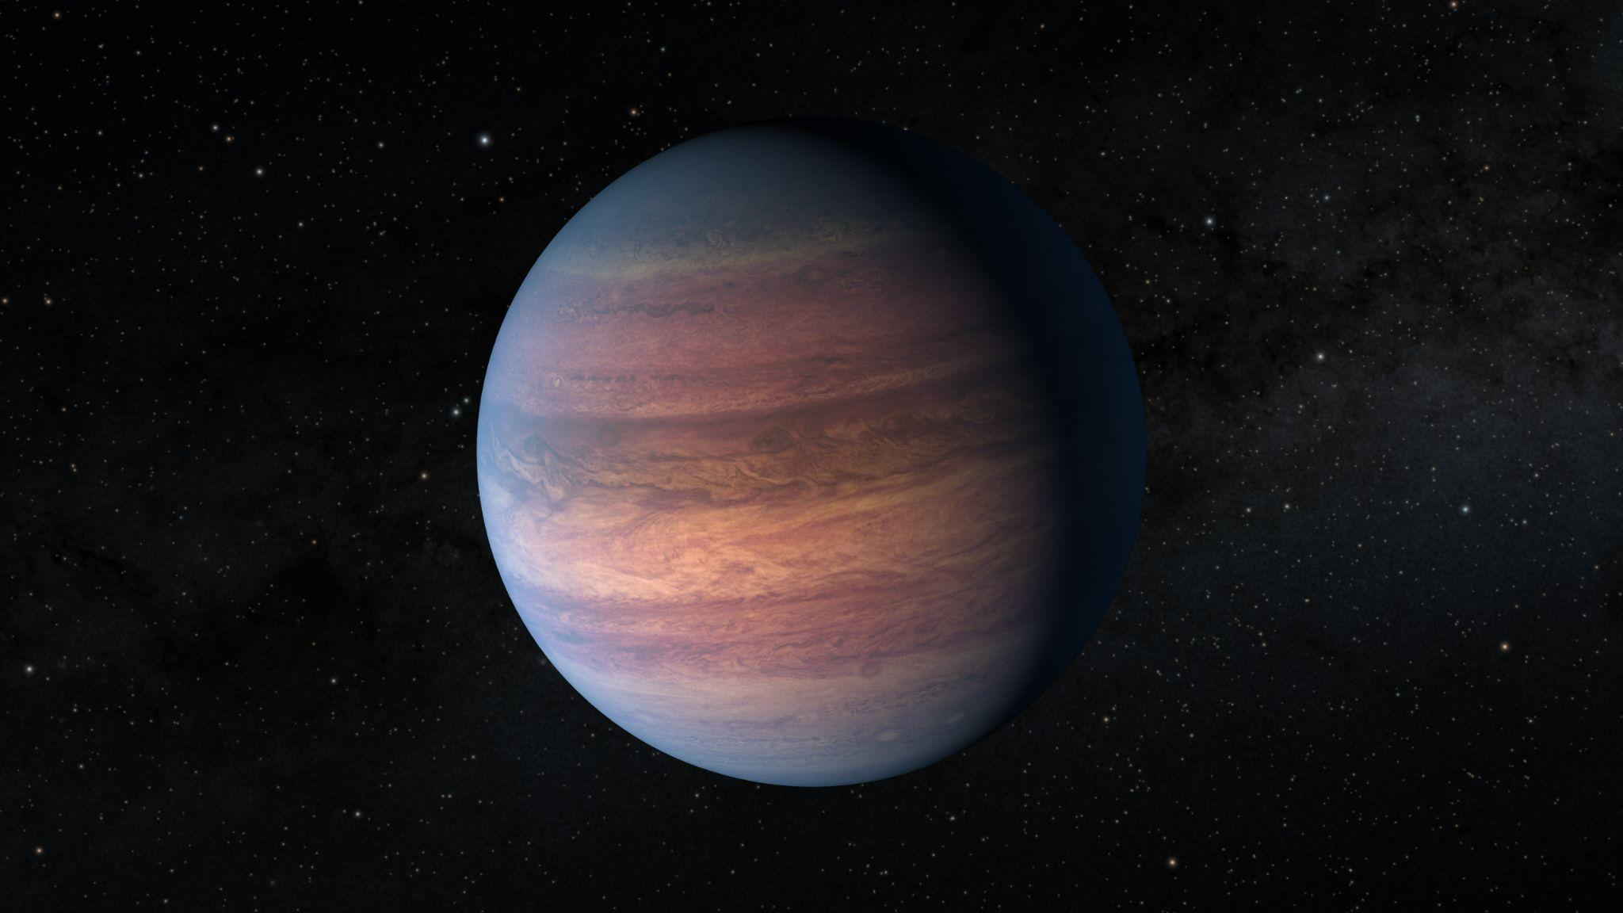
Working of GANs
System Architecture
Expected Results

Slide 6
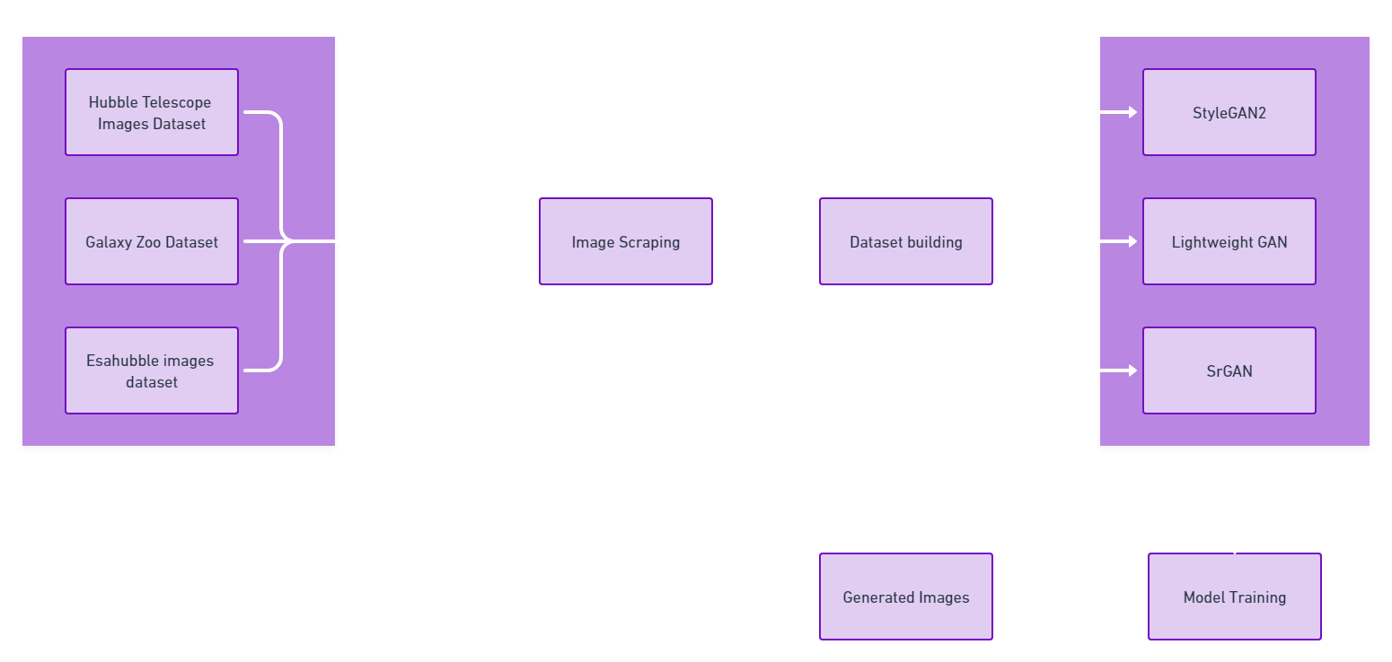
Image Sources
Various GANs Used

Slide 7
02
TechStack
Tools and Technologies Used

Slide 8
Tools and Technologies
Deep Learning
Artificial Intelligence
Generative Adversarial Networks (GANs)
Convolutional Neural Networks (CNN)
Python
Pytorch
StyleGAN2
Lightweight GAN
SrGAN
Flickr Scraper
Jupyter Notebook

Slide 9
03
WorkFlow
Current progress of the project

Slide 10
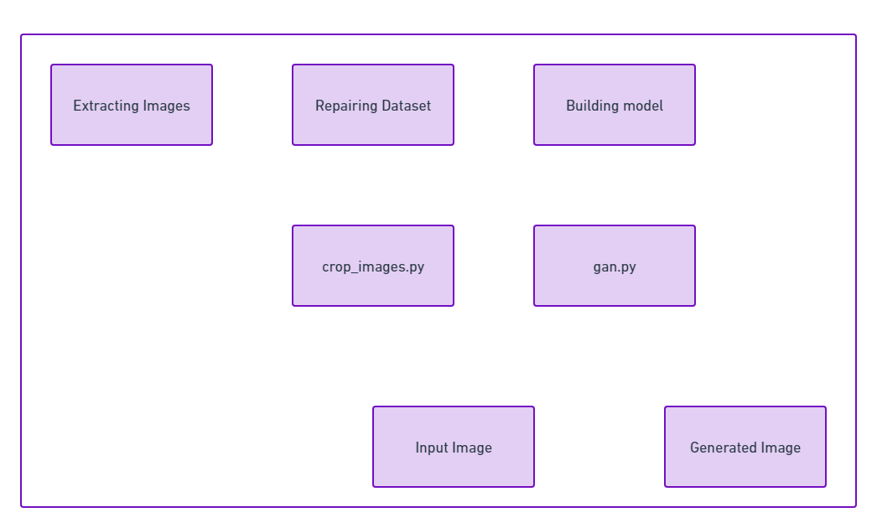
WorkFlow
from P1 to P2 (What we did…)
INPUT
OUTPUT

Slide 11
Human VS AI image recognition
Imagine recognition is done by using natural neural networks.
Natural neural networks help humans to identify items in the images gained from previous experiences.
We see the images in their visual form, and can easily differentiate the edges and colors.
Machines recognise an image using artificial neural networks.
Machines store the images in the form of numbers.
Machines only looks at the pixel values and patterns in these values. They take pixel patterns and compare them with other patterns

Slide 12
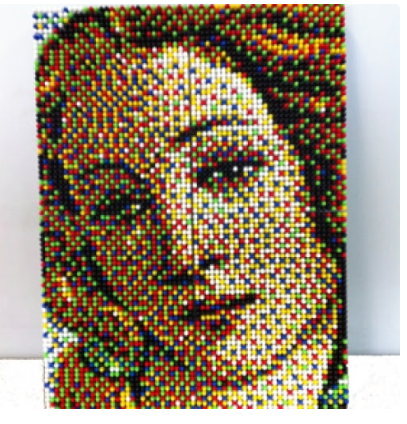
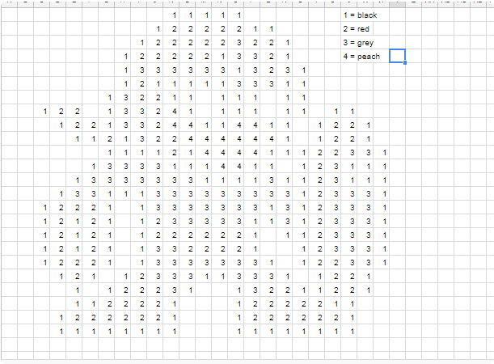

Slide 13
04
Results
Currently where we are…

Slide 14
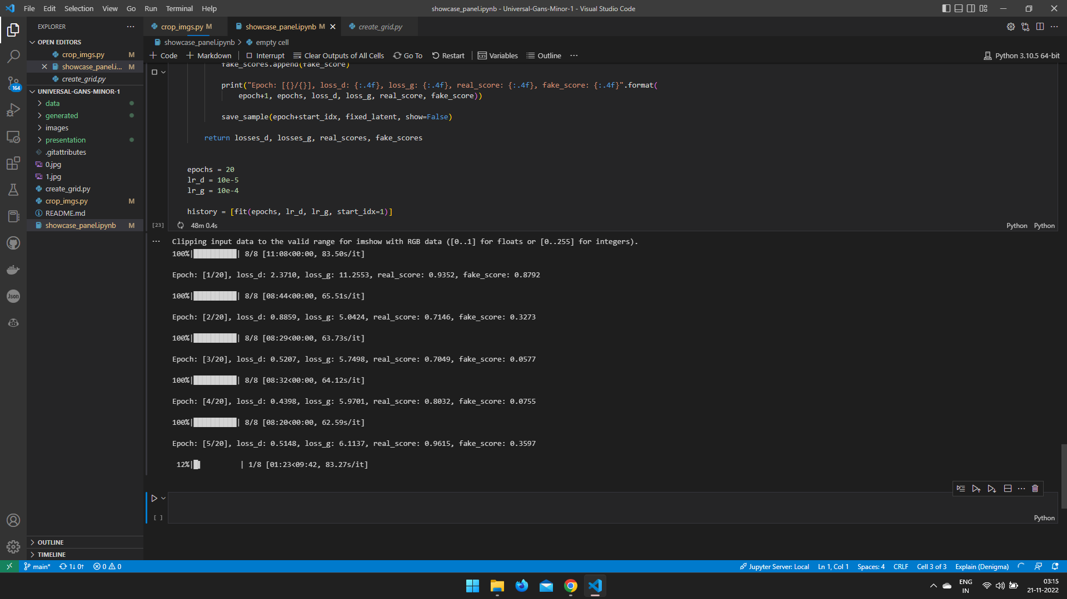

Slide 15
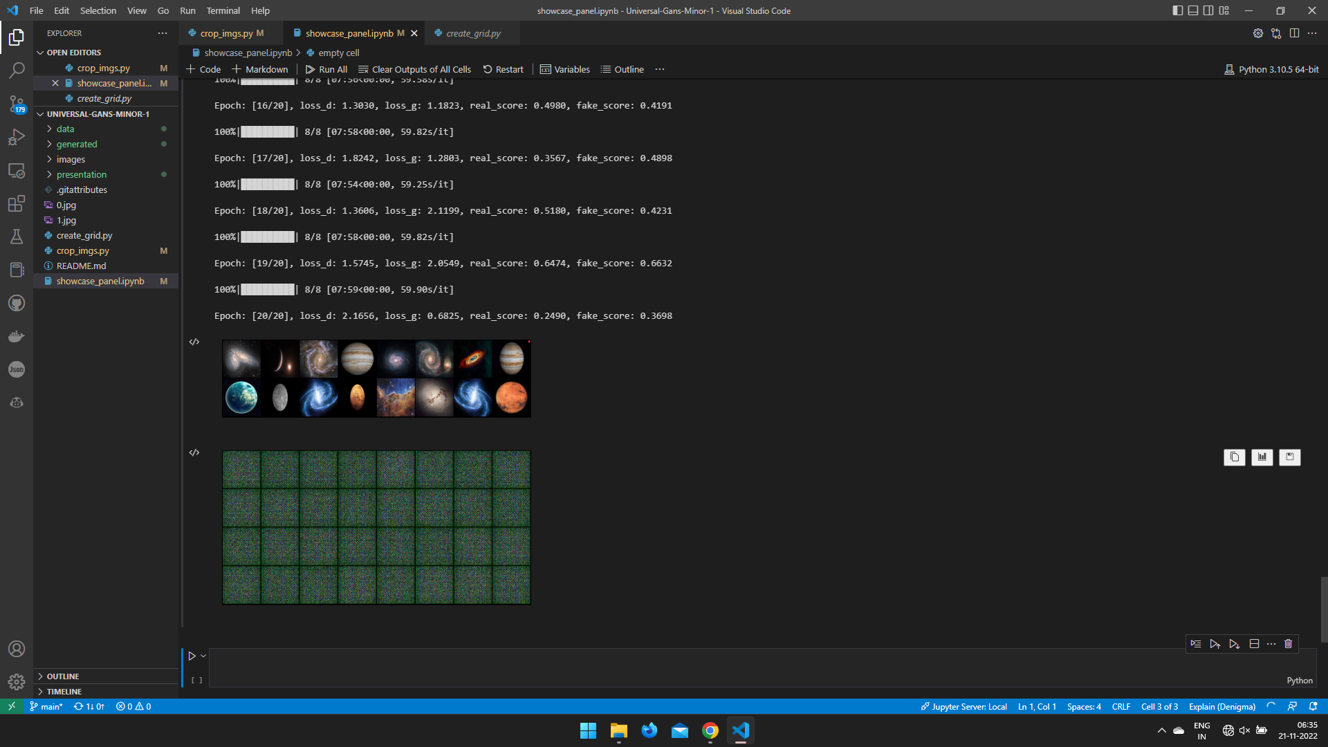

Slide 16

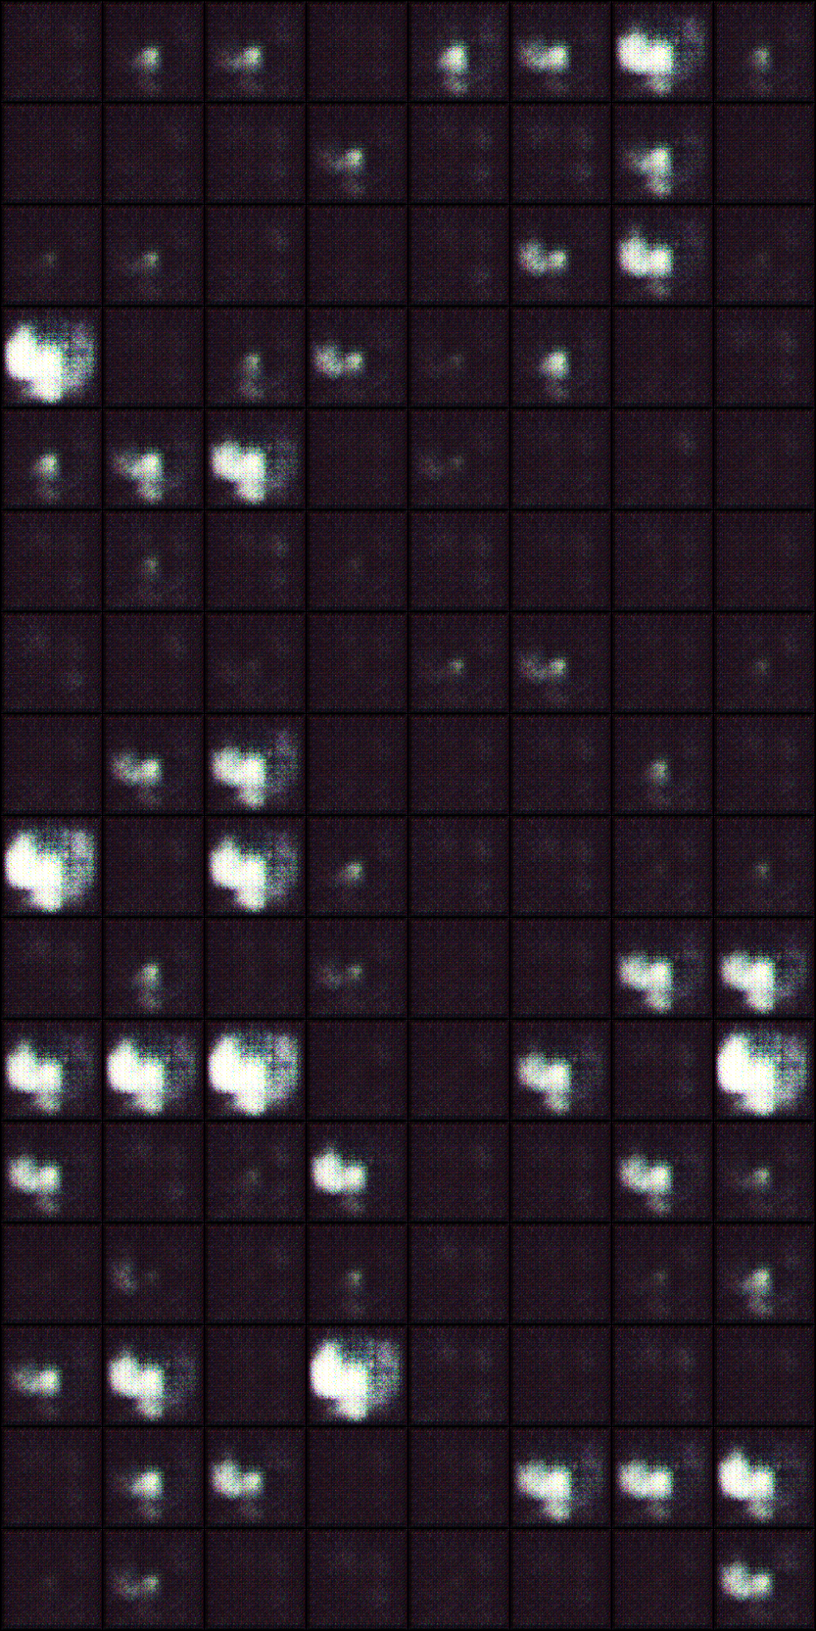
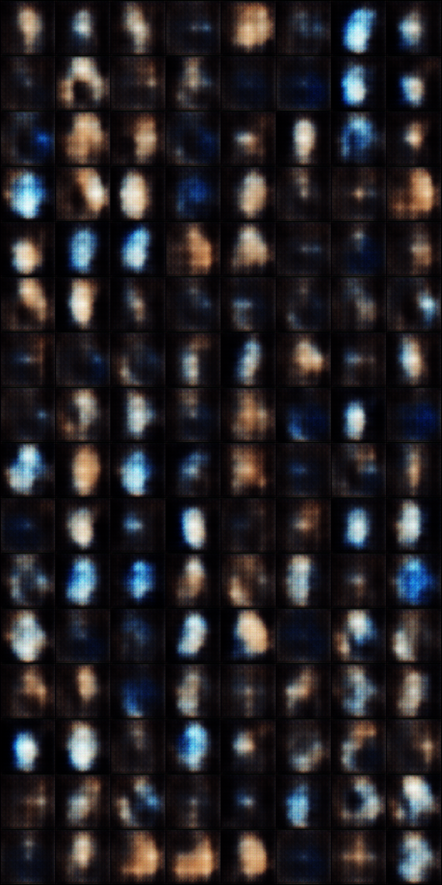

Slide 17
How is our work helpful in real life
People have wondered whether it’s possible to use GANs for generating training data to be used in low-data regimes. There hasn’t been much success there but it’s possible to meld two sources of data for generating more realistic and useful training data. For instance, a research team at Apple showed that you can leverage large unlabeled data and feed it to a refiner (powered by GANs) which is trained to generate more realistic training data given some base labeled synthetic data. This can reduce the cost of generating supervised datasets and help on a variety of machine learning tasks that weren’t addressed before.
GANs can help get over the data scarcity problem, particularly in areas like medicine where labeled data is scarce and costly.
GANs are widely used for voice generation, image generation or video generation.
the future of GANs is bright and there are several areas in which GANs will be used shortly including Creating infographics from the text, Generating website designs, Compressing data, Drug discovery and development, Generating text, Generating music
GAN does not use element- wise similarity measure by construction which gives GANs an ability to predict more accurately. In training time, an inference network estimates the distribution of latent variables, while a generative network learns to reconstruct input space from the latent variables.

Slide 18
Timeline
Building and Training Model
Research
Dataset Creation
P1
P2
P2
P2
P3
P3
Scraping Images
GANs Application
Outcomes

Slide 19

Our Team
Garima Shukla
201B109
Vani Seth
201B299
Tanish Khandelwal
201B283

Slide 20
THANK YOU

